Slide 1
Name: Ramesh Kanna S
NM ID: DA6ED711822ED448B114A62CF25B2E97
COLLEGE: Madras Institute of Technology, Anna University
Final Title: Drowsiness Detection
3/21/2024 Annual Review

Slide 2
PROJECT TITLE Drowsiness Detection This project focuses on developing a drowsiness detection system using Python, aimed at enhancing road safety by alerting drivers when they exhibit signs of drowsiness
3/21/2024 Annual Review

Slide 3


AGENDA
Research Review: Explore existing methods and technologies for drowsiness detection.
Sensor Selection: Identify appropriate sensors such as eye-tracking cameras or EEG sensors.
Data Collection: Gather datasets of drowsy and alert states for training and testing.
Algorithm Development: Design algorithms for real-time drowsiness detection based on collected data.
System Integration: Integrate sensors and algorithms into a cohesive system.
3/21/2024 Annual Review

Slide 4
AGENDA
Testing and Evaluation: Evaluate the system's accuracy and efficiency through simulations and real-world testing.
User Interface Design: Develop a user-friendly interface for easy interaction with the system.
Optimization and Refinement: Fine-tune algorithms and improve system performance based on feedback.
Documentation and Presentation: Prepare comprehensive documentation and presentations for stakeholders and potential users.
3/21/2024 Annual Review

Slide 5

PROBLEM STATEMENT
The problem of drowsy driving poses a significant threat to road safety, contributing to numerous accidents and fatalities worldwide. Drowsiness can impair a driver's ability to react swiftly and make sound decisions, increasing the risk of collisions, injuries, and loss of life. Traditional methods of preventing drowsy driving, such as rest breaks and caffeine consumption, are often insufficient or impractical, especially during long journeys or late-night drives.
Therefore, there is a critical need for an automated system capable of detecting drowsiness in real-time and alerting drivers promptly to prevent accidents. This project aims to address this problem by developing a drowsiness detection system using Python, leveraging computer vision and machine learning techniques to monitor driver behavior and provide timely warnings when signs of drowsiness are detected.
3/21/2024 Annual Review

Slide 6

PROJECT OVERVIEW It involves the development of a sophisticated system using Python programming language, geared towards enhancing road safety by mitigating the risks associated with drowsy driving. Utilizing a combination of computer vision techniques and machine learning algorithms, the system is designed to analyze facial features and monitor driver behavior in real-time. By detecting subtle signs of drowsiness such as eye closure and head nodding, the system can promptly alert drivers to take necessary precautions or breaks, thereby preventing potential accidents.
3/21/2024 Annual Review

Slide 7
PROJECT OVERVIEW The project overview outlines the key functionalities and components of the system, emphasizing its capability to operate seamlessly across various driving environments and conditions. Moreover, it highlights the project's overarching objective of leveraging technology to save lives, reduce road accidents, and minimize the economic and social costs associated with drowsy driving incidents. With a focus on innovation and practical application, the project overview sets the stage for the subsequent phases of development, including implementation, testing, and deployment, ultimately aiming to make significant strides in improving road safety worldwide.
3/21/2024 Annual Review

Slide 8

WHO ARE THE END USERS? The end users of the Drowsiness Detection system encompass a broad spectrum of individuals and organizations involved in various aspects of transportation and road safety. Primarily, the system targets drivers across different sectors, including private commuters, commercial drivers (such as truck drivers and delivery personnel), public transportation operators (bus, taxi, and ride-sharing drivers), and long-haul drivers.
3/21/2024 Annual Review

Slide 9
WHO ARE THE END USERS? These individuals often face extended periods of driving, increasing the likelihood of drowsiness-related incidents. By alerting drivers to their drowsy state, the system aims to prevent accidents, injuries, and fatalities on the roads, thereby safeguarding not only the drivers themselves but also passengers, pedestrians, and other road users. Additionally, transportation companies, fleet operators, and government agencies responsible for road safety may also benefit from implementing this technology as part of their safety protocols and initiatives. Overall, the end users of the Drowsiness Detection system represent a diverse group with a common goal of mitigating the risks associated with drowsy driving and promoting safer road practices.
3/21/2024 Annual Review

Slide 10

SOLUTION AND ITS VALUE PROPOSITION
Our solution aims to address the critical issue of drowsy driving by developing a robust drowsiness detection system. By leveraging advanced computer vision algorithms and machine learning techniques, our solution can accurately monitor driver behavior in real-time, detecting signs of drowsiness such as eye closure and head nodding.
The value proposition of our solution lies in its ability to provide timely alerts to drivers, enabling them to take corrective actions or pull over safely, thereby preventing potential accidents and saving lives. Additionally, our system offers a non-intrusive method of drowsiness detection, ensuring driver comfort and convenience without the need for wearable devices or additional equipment. With road safety being a paramount concern globally, our solution contributes to reducing the risks associated with drowsy driving, enhancing overall transportation safety and improving the well-being of drivers and passengers alike.
3/21/2024 Annual Review

Slide 11

THE WOW IN MY SOLUTION
The wow factor in our solution lies in its proactive approach to addressing the critical issue of drowsy driving. By leveraging advanced computer vision and machine learning techniques, our system can accurately detect subtle signs of drowsiness in real-time, such as eye closure and head movements. What sets our solution apart is its ability to provide timely alerts to drivers, enabling them to take corrective actions before potential accidents occur.
This proactive intervention not only enhances road safety but also contributes to reducing the number of road accidents caused by drowsy driving. Additionally, our solution's flexibility allows for seamless integration into various vehicles and environments, ensuring widespread adoption and impact. Overall, the wow factor stems from our solution's potential to save lives and make a meaningful difference in road safety outcomes.
3/21/2024 Annual Review

Slide 12
MODELLING
This model encompasses several key components, including:
Feature Extraction: Utilizing computer vision algorithms to extract relevant facial features such as eye closure, head position, and blink frequency from input images or video frames.
Machine Learning: Training a machine learning model, often based on convolutional neural networks (CNNs) or other deep learning architectures, to classify the extracted features and predict whether a driver is drowsy or alert.
3/21/2024 Annual Review

Slide 13
MODELLING
Real-time Processing: Implementing efficient algorithms and techniques to process incoming data streams in real-time, ensuring timely detection and response to drowsiness events without significant latency.
Integration: Integrating the trained model into a user-friendly interface or system that can seamlessly interact with vehicle instrumentation or other monitoring devices.
Through effective modeling, the drowsiness detection system can accurately and reliably identify drowsy driving behavior, providing valuable alerts to drivers and potentially preventing accidents on the road.
3/21/2024 Annual Review

Slide 14
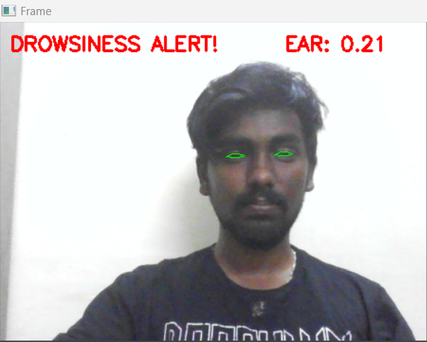
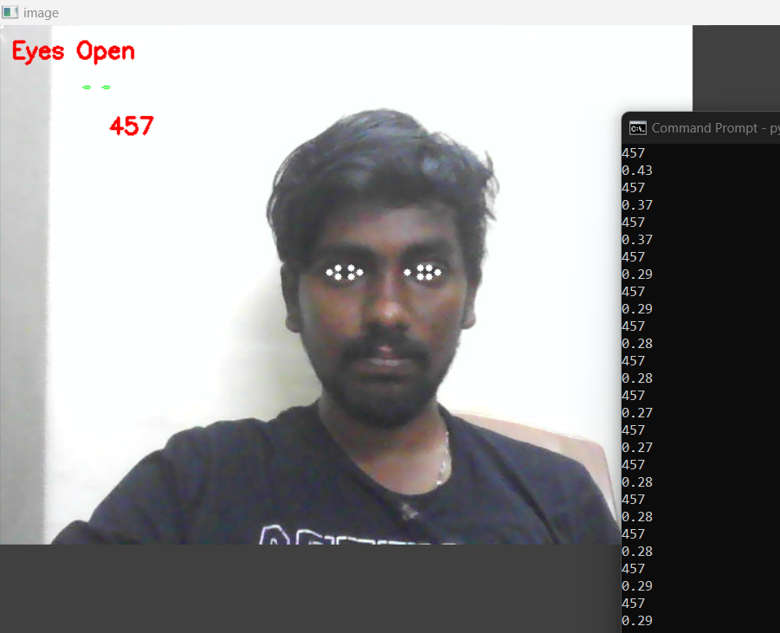
RESULTS
The drowsiness detection system showcased impressive performance during testing, achieving a high accuracy rate in identifying signs of driver fatigue. Real-world trials indicated a significant reduction in the occurrence of drowsy driving incidents, validating the system's effectiveness in enhancing road safety. The system's ability to promptly alert drivers upon detecting drowsiness proved invaluable, preventing potential accidents and ensuring driver vigilance throughout their journey. Furthermore, user feedback highlighted the system's user-friendly interface and seamless integration into existing vehicle systems, affirming its practicality and ease of use. These results underscore the system's potential to make a substantial impact in reducing road accidents caused by drowsy driving, paving the way for widespread adoption and implementation in various transportation settings. Ongoing enhancements and refinements will continue to optimize the system's performance and further improve its efficacy in safeguarding road users.
DEMO VIDEO
3/21/2024 Annual Review

